Slide 1
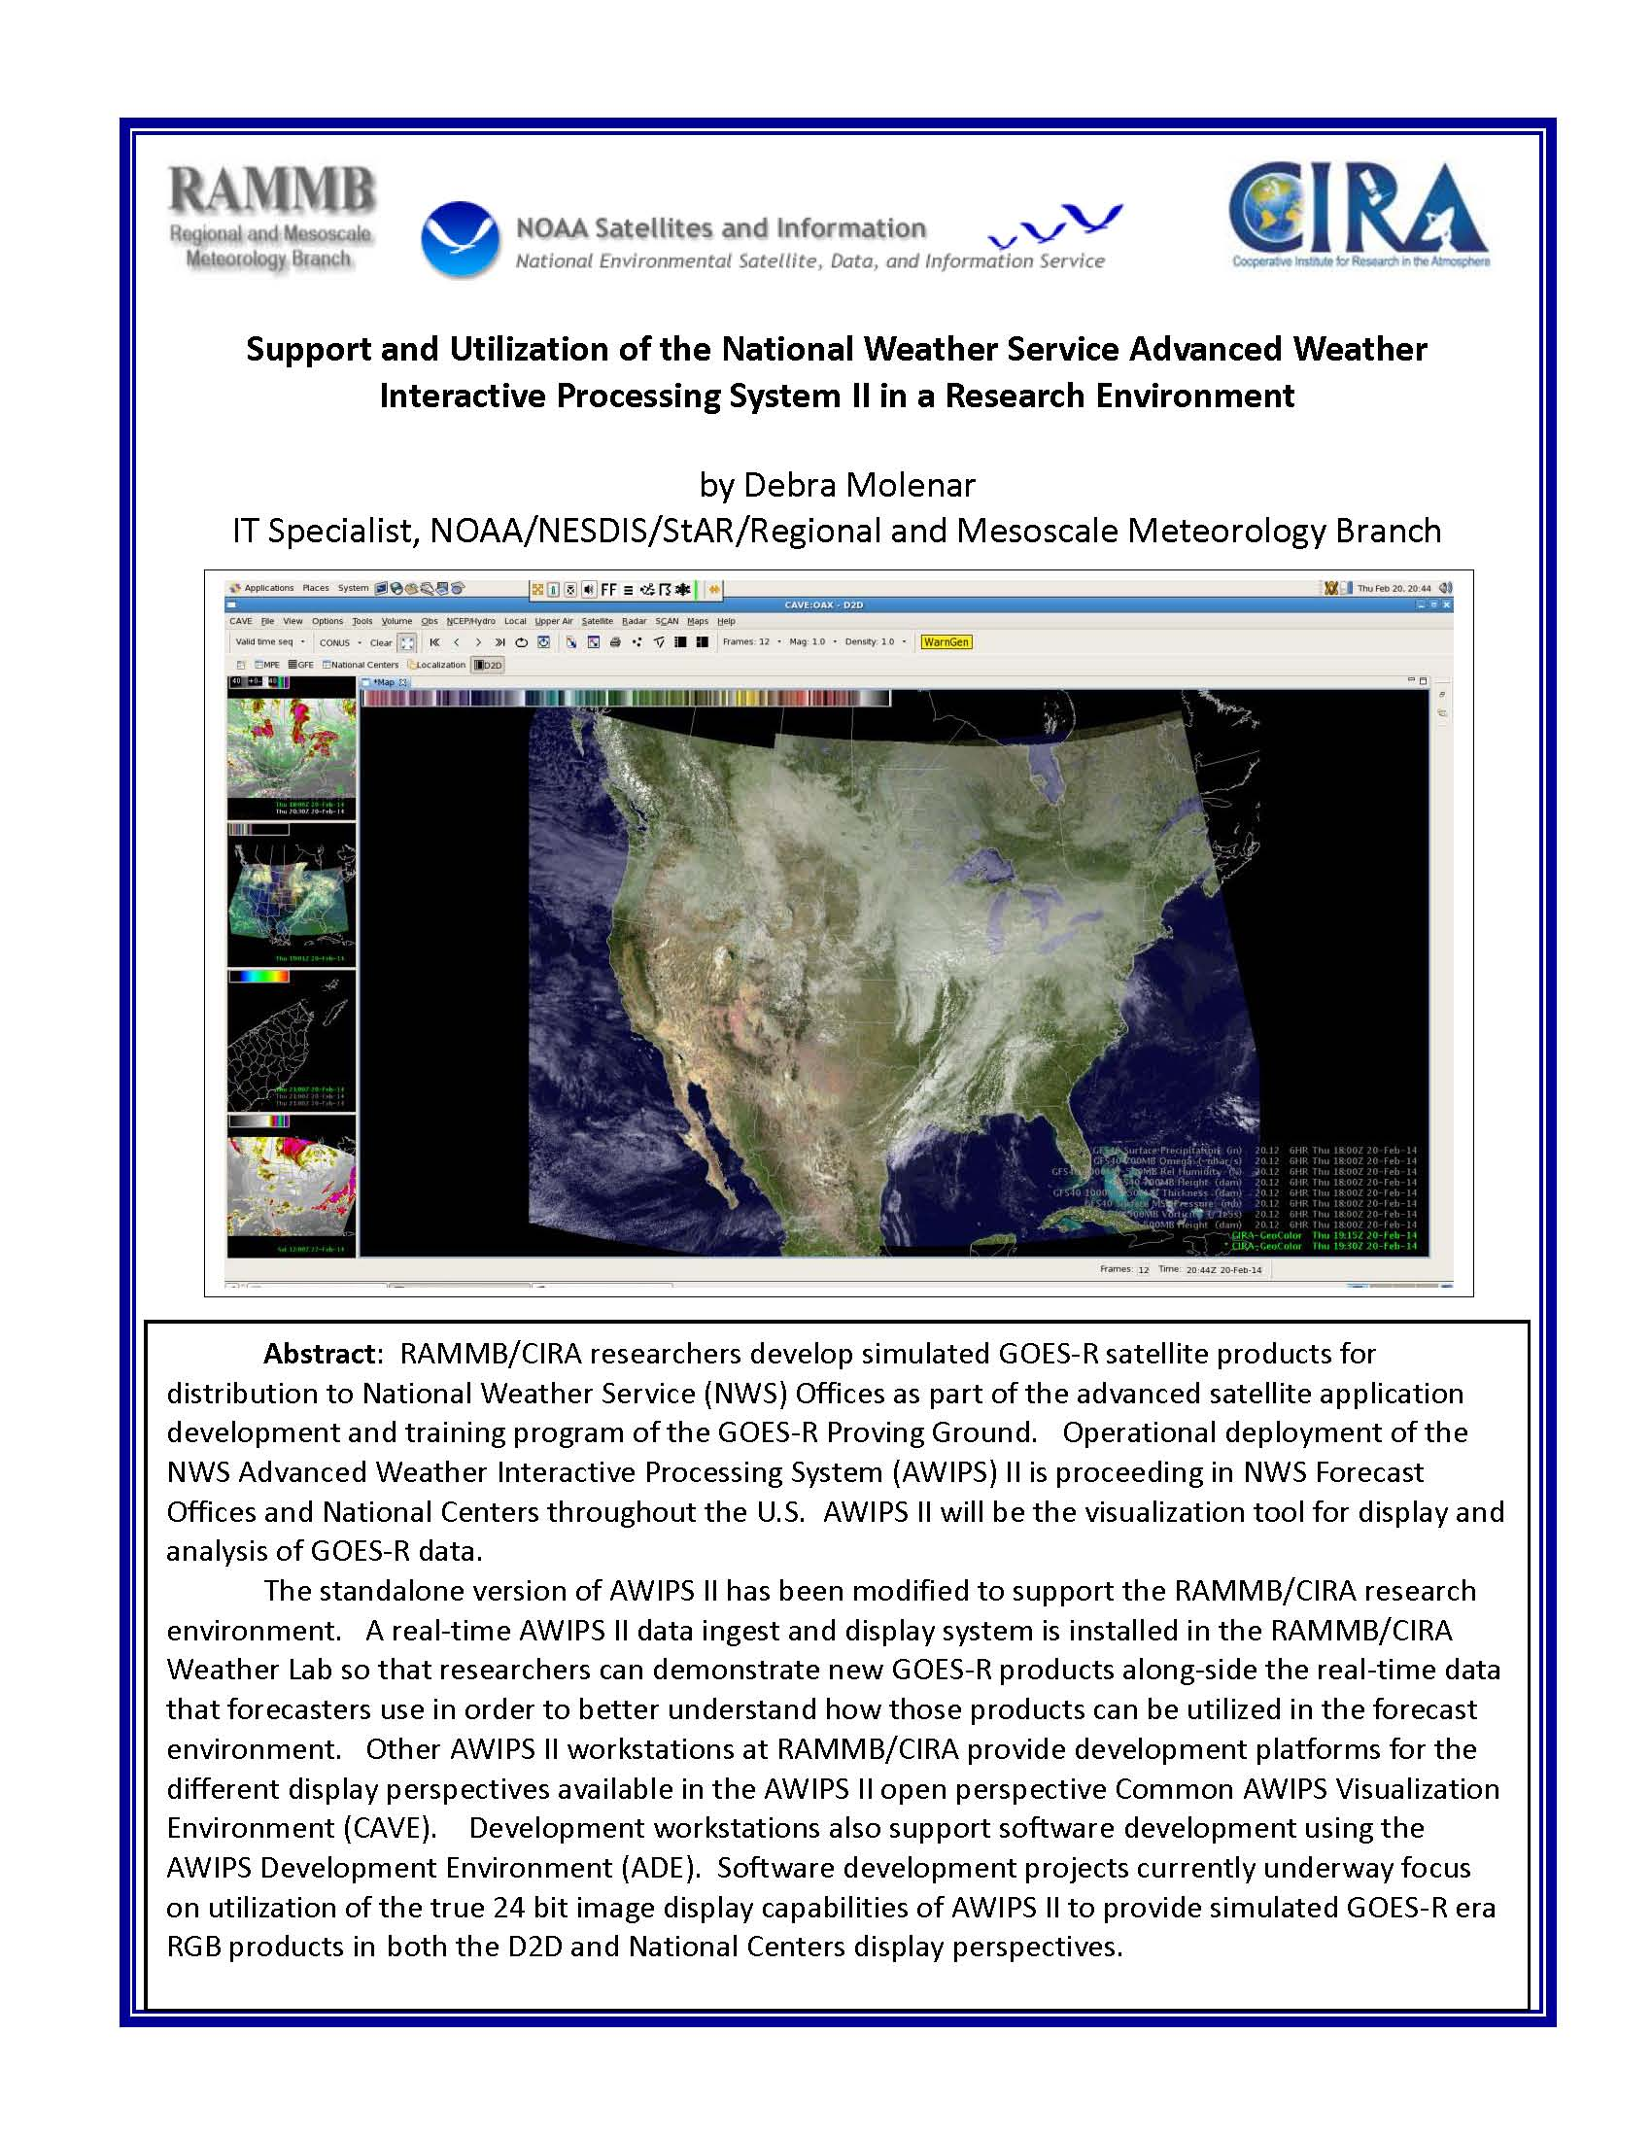

Slide 2
Outline
RAMMB/CIRA Overview
RAMMB/CIRA real-time product development & deployment environment
GOES-R Proving Ground
AWIPS II Overview
AWIPS II Configuration at RAMMB/CIRA
Support Challenges
Solutions
Summary

Slide 3
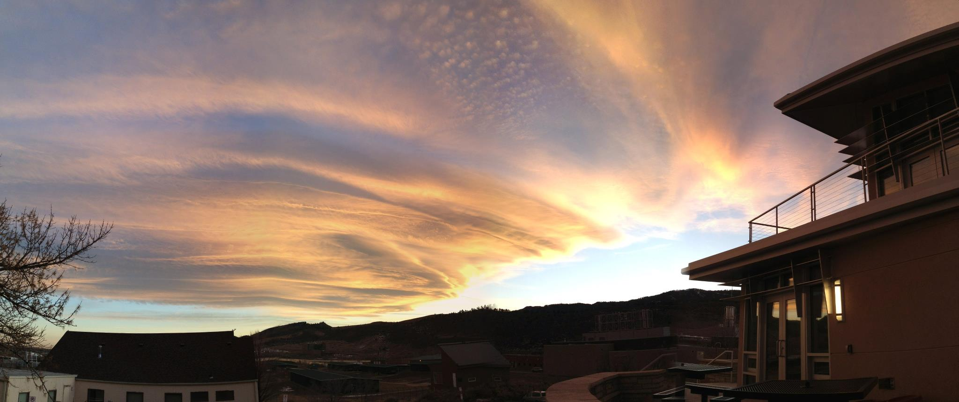
RAMMB/CIRA
The Regional and Mesoscale Meteorology Branch (RAMMB) of NOAA/NESDIS conducts research on the use of satellite data to improve analysis, forecasts and warnings for regional and mesoscale meteorological events.
RAMMB is co-located with the Cooperative Institute for Research in the Atmosphere (CIRA) at Colorado State University in Fort Collins, CO.

Slide 4
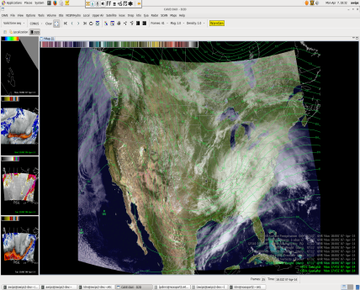
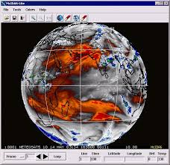
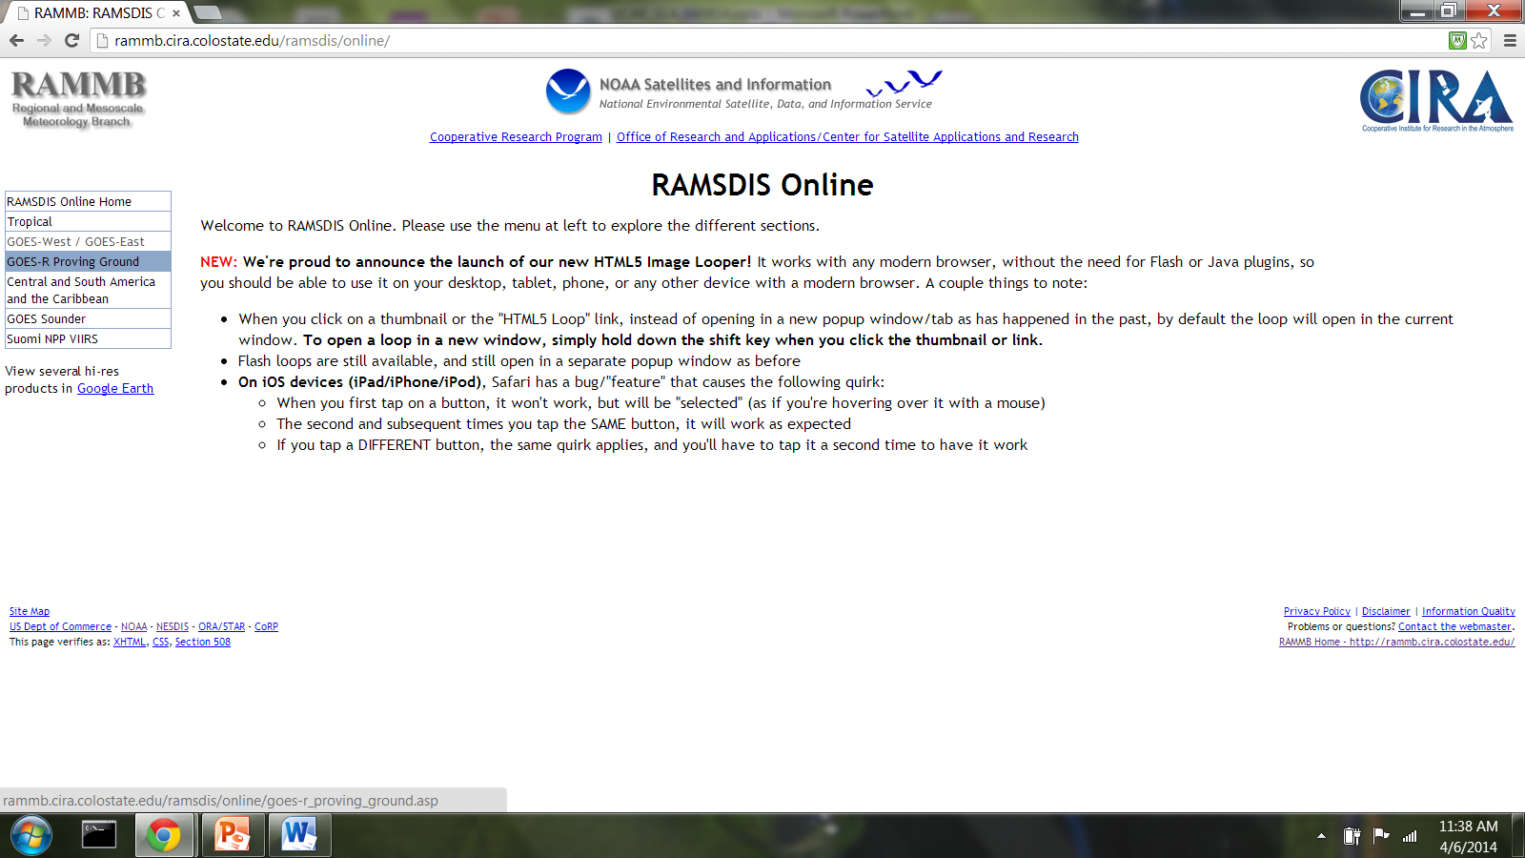
RAMMB/CIRA Research Product Development Environment
Research staff experimental product development
NAWIPS, AWIPS I & II
LDM
b
LDM
(backup)
McIDAS
ADDE
server
Internet
RAMSDIS Online

Slide 5
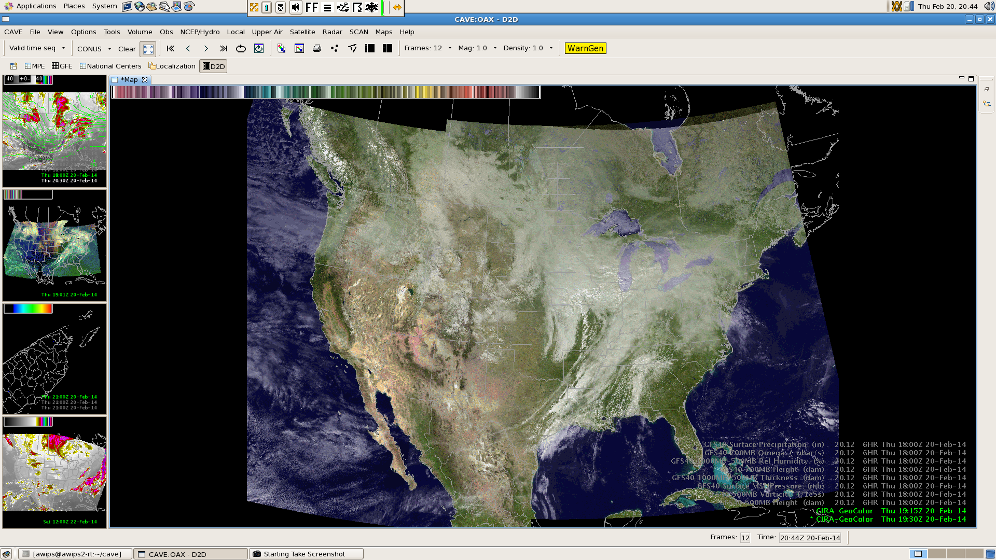
Sample Products

Slide 6
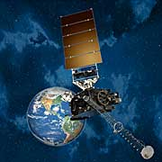
The GOES-R Proving Ground
The Geostationary Operational Environmental Satellites-R Series (GOES-R) is the next generation of geostationary
Earth-observing systems
The first satellite in the GOES-R series is scheduled for
launch in early 2016
The GOES-R Proving Ground is a collaborative effort between the GOES-R Program Office, NOAA Cooperative Institutes, a NASA center, NWS Weather Forecast Offices, NCEP National Centers, and NOAA Test Beds across the country
Goal is to provide simulated GOES-R products that can be tested and evaluated before the GOES-R satellite is launched into space

Slide 7
AWIPS II Overview
Primary data ingest and display platform of NWS Forecast Offices and National Centers
Uses existing open source technologies such as Java, Apache Qpid, PostgreSQL, and PyPIES
Service Oriented Architecture (SOA) – all source is available
Can modify existing plugins & create new plugins via Eclipse and AWIPS Development Environment (ADE)
Customized via xml files, localization perspective and java plugins
All data must be ingest into database (metadata) + HDF store via a java plugin (specific input data formats)
LDM ingests data from NOAAPORT; experimental data is dropped into manual endpoint

Slide 8
AWIPS II Overview
Raytheon provides a separate ‘standalone’ build (server and client on the same machine) for external partners
This public version of AWIPS II software (excluding proprietary code) is freely available
True 24/32 bit display capabilities in both hardware & software
Important for fusion of new advanced datasets
Documentation is getting there…
◊ ◊ ◊
Complexity and ongoing evolution makes it challenging to manage in a research environment

Slide 9
WFO vs CIRA AWIPS CONFIGURATION c

Slide 10
AWIPS II Support Challenges
The standalone builds are a separate release (available AFTER the WFO release)
No direct support from Raytheon
OS configuration details not known
Software is still evolving rapidly. Many times major upgrades don’t work ‘out of the box’, so there is a deployment delay
RAMMB/CIRA products have to be manually added to each new build
RAMMB/CIRA is not an operational environment. Need to provide reliable 24/7 operational products to clients
Limited staff; beta products sometime come directly from researcher workstations
Supporting 2 display perspectives: National Centers Perspective is based on NAWIPS and is used by the National Centers, D2D is based on AWIPS I and is used by the WFOs
Also supporting AWIPS I & N-AWIPS product distribution

Slide 11
(some) Solutions to Support and Timeliness Issues
There is already a broad user community. Several virtual communities help mitigate support and timeliness issues
The NWS Virtual Lab is now hosting multiple builds, which can be downloaded via git and deployed via the ADE (Eclipse development environment)
The NASA SPoRT Experimental Product Development Team (EPDT) has provided hands-on ADE plugin development training and holds bi-weekly telecons on various topics
The Raytheon Developer’s Forum bi-weekly telecon allows external partners to share information, submit questions and provide feedback to Raytheon developers
AWIPS II Developers mail list also provides a forum for bug fix info

Slide 12
(some) Solutions to Deployment Issues
Rapidly evolving software and sometimes lengthy in-house deployment times
Maintain a rotating set up of workstations
one functional real-time ingest and display system and one software development system always available
Only deploy major upgrades (as opposed to every bi-monthly release)
Develop pre-configured bundles for menu and product import
PG Partners group is working on standardized installation templates hosted by the VLAB
Utilize ADAM builds/NWS ITO partners to help with OS configuration questions
Utilize ADE to debug & fix broken components

Slide 13
(some) Solutions to Operational Support Requirements
Non-operational support for operational partners
Monitoring scripts at multiple points of data dissemination for broadcast verification
Real-time system is involved in daily weather discussions; provides visual and distribution monitoring
All products also go to web based RAMSDIS Online where there are additional automated checks
Implementation of deployment zone & standardized templates for all product deployment
Products are emanating from many systems
Difficult to trouble-shoot products that are being generated on researchers systems

Slide 14
RAMMB/CIRA Research Product Development Environment
Research staff experimental product development systems
NAWIPS, AWIPS I & II
beta product transition system
LDM
b
LDM
(backup)
McIDAS
ADDE
server
operational product development system
Internet
RAMSDIS Online

Slide 15
(some) Solutions to Operational Support Requirements
Non-operational support for operational partners
Implementation of deployment zone
Beta system: IT staff works with researcher to harden code used to generate (proven) products
Use of templates standardizes the process
Operational system: Products generated on operational system that only IT staff has access to
Subversion controlled
All input data needed is ingest/stored on primary + backup servers

Slide 16
(some) Solutions to Limited Staff/multiple platforms
Limited staff supporting 2 display perspectives
National Centers Perspective is based on N-AWIPS and is used by the National Centers
D2D is based on AWIPS I and is used by the WFOs
Different software/same framework
One in-house expert for each
Rely heavily on EPDT and remote collaborative work via the VLAB
Also support from National Centers and liasons
Redmine project checkout for individual (remote) ADE development efforts

Slide 17
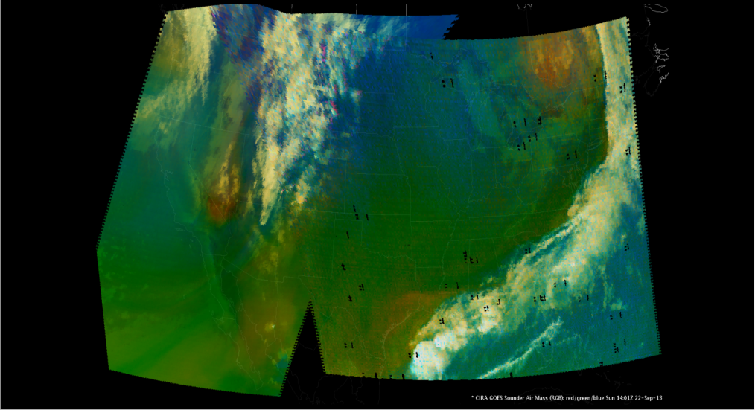
AWIPS II Software Development for 24 bit (RGB) Image Display
The AWIPS II EPDT RGB working group has developed a beta version of an AWIPS II plugin to display GOES data in 24 bits (modified from VIIRS true color display code).
24 bit displays on the right were created from pre-derived red, green and blue imagery.
The working group is now focused on development of ‘on-the-fly’ creation of red, green and blue image components using AWIPS II python capabilities.

Slide 18
Summary
AWIPS II is a powerful tool with much potential
The advanced capabilities and large user base provide many opportunities for collaboration and data sharing
Large user community that is willing to share experience. Experience is evolving
Challenges are offset by rewards when a product is utilized in the field.
Debra.Molenar@noaa.gov

